Slide 1
Integer Functions
By Hasan Murad
Lecturer
CSE, UAP

Slide 2
FLOORS AND CEILINGS
Floor Function
Ceiling Function
Kenneth E. Iverson introduced this notation.
His notation has become sufficiently popular that floor and ceiling brackets can now be used in a technical paper without an explanation of what they mean.

Slide 3
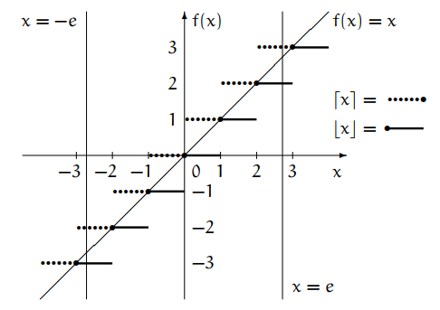
FLOORS AND CEILINGS GRAPH

Slide 4





Properties of FLOOR AND CEILING Function

Slide 5
Properties of FLOOR AND CEILING Function

Slide 6
Properties of FLOOR AND CEILING Function

Slide 7
Properties of FLOOR AND CEILING Function

Slide 8
Properties of FLOOR AND CEILING Function

Slide 9
Properties of FLOOR AND CEILING Function

Slide 10
Properties of FLOOR AND CEILING Function

Slide 11
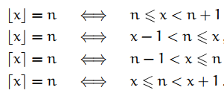
Rules for FLOOR AND CEILING Function

Slide 12

Rules for FLOOR AND CEILING Function

Slide 13
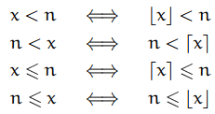
Redundant Use of FLOOR AND CEILING Function

Slide 14

Fractional Part

Slide 15


Fractional Part

Slide 16
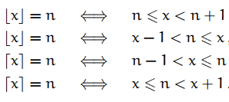

FLOOR/CEILING APPLICATIONS
How many bits are needed to represent a number n in binary representation?
Let the number n has m bits in its binary representation.
Question?
Range of Number that can be representation in binary by using m bit?

Slide 17
FLOOR/CEILING APPLICATIONS

Slide 18


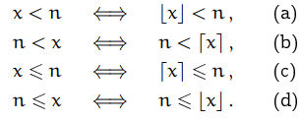


FLOOR/CEILING APPLICATIONS

Slide 19

FLOOR/CEILING APPLICATIONS

Slide 20
FLOOR/CEILING APPLICATIONS
Let f(x) be any continuous, monotonically increasing function with the property that

Slide 21

FLOOR/CEILING APPLICATIONS

Slide 22

FLOOR/CEILING APPLICATIONS

Slide 23
FLOOR/CEILING APPLICATIONS
Close Interval
Open Interval
Half Open Interval
How many integers are contained in such intervals?

Slide 24
FLOOR/CEILING APPLICATIONS
How many integers are contained in such intervals?

Slide 25

FLOOR/CEILING APPLICATIONS

Slide 26
FLOOR/CEILING APPLICATIONS

Slide 27
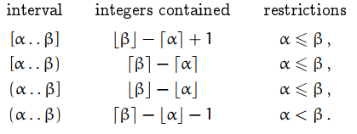
FLOOR/CEILING APPLICATIONS

Slide 28

Roulette Wheel Problem
There's a roulette wheel with one thousand slots, numbered 1 to 1000.
How many integers n, where 1 <= n <= 1000, satisfy the relation
?

Slide 29

Roulette Wheel Problem
Then it's a winner and the house pays us $5; otherwise it's a loser and we must pay $1.
Let the number of winners W, then the number L = 1000 - W of losers.

Slide 30
How can we count the number of winners among 1 through 1000?
It's not hard to spot a pattern.
The numbers from 1 through 2^3 - 1 = 7 are all winners because
for each.
Among the numbers 2^3 = 8 through 3^3 - 1 = 26, only the even numbers are winners.
And among 3^3 = 27 through 4^3 - 1 = 63, only those divisible by 3 are. And so on.

Slide 31






Roulette Wheel Problem

Slide 32




Roulette Wheel Problem
(6*172 - 1000)/1000 dollars, which is 3.2 cents

Slide 33




The General Solution of Roulette Wheel Problem

Slide 34

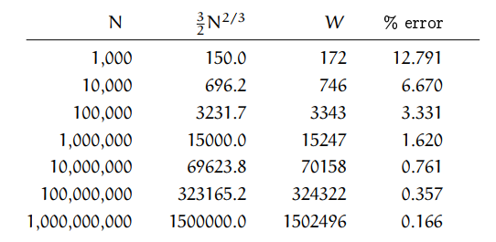
The Approximate Solution of Roulette Wheel Problem

Slide 35
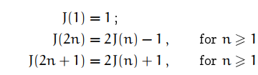

The General Solution of Josephus problem
Josephus problem in which every third person is eliminated, instead of every second.

Slide 36
The General Solution of Josephus problem
There's another approach to the Josephus problem that gives a much better setup.
Whenever a person is passed over, we can assign a new number.
Thus, 1 and 2 become n + 1 and n + 2
then 3 is executed
4 and 5 become n + 3 and n + 4
then 6 is executed
3k + 1 and 3k + 2 become n + 2k + 1 and n + 2k + 2
then 3k + 3 is executed
then 3n is executed (or left to survive)

Slide 37
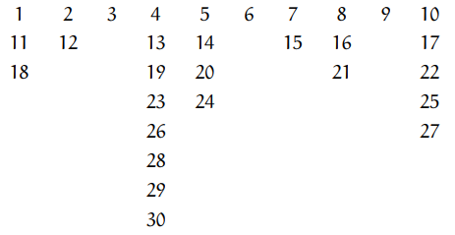
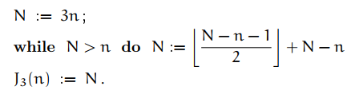
The General Solution of Josephus problem
For example, when n = 10 the numbers are
The kth person eliminated ends up with number 3k. So we can figure out who the survivor is if we can figure out the original number of person number 3n.

Slide 38
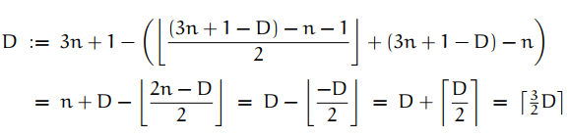


Slide 39
